Slide 1
Sentiment Analysis for Multilingual Social Media Posts
Medhini barla
Raghuram santhoshi Reddy
Likhitha Gupta thallapally

Slide 2

Introduction
Objective: Sentiment Analysis for Multilingual Social Media Posts
Features:
Analyzing sentiments in CSV and Text files
Predicting accuracy using BERT models

Slide 3

GUI Components
Components:
File Selection: Browse and load CSV or Text files
Analyze Sentiment Button
Result Labels
Listbox for Sentiment Outputs

Slide 4
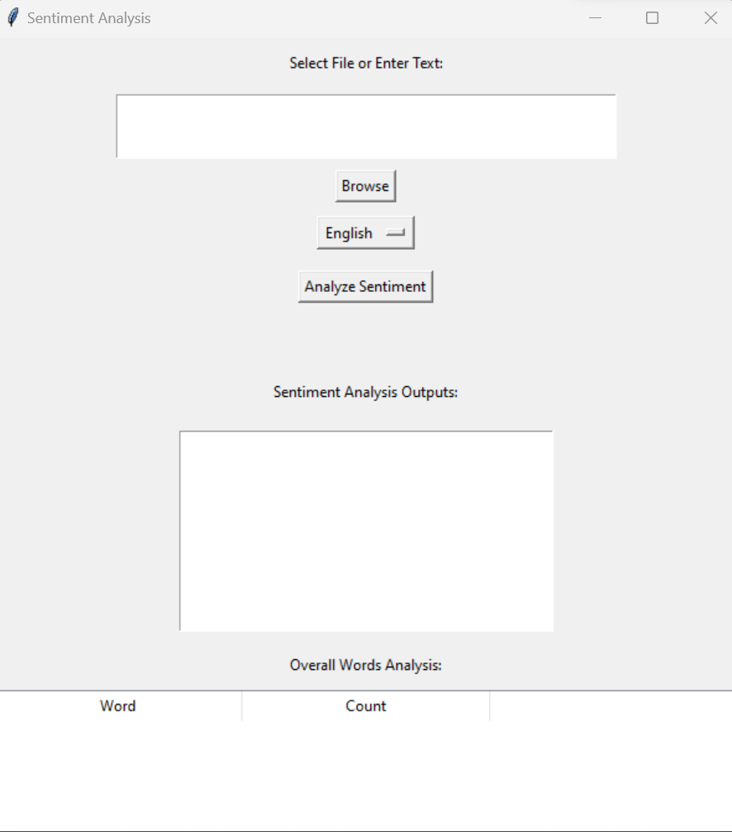
GUI Components

Slide 5
Functionality:
Use the 'Browse' button to select and load CSV or Text files
Display the loaded file path and the number of entries

Slide 6
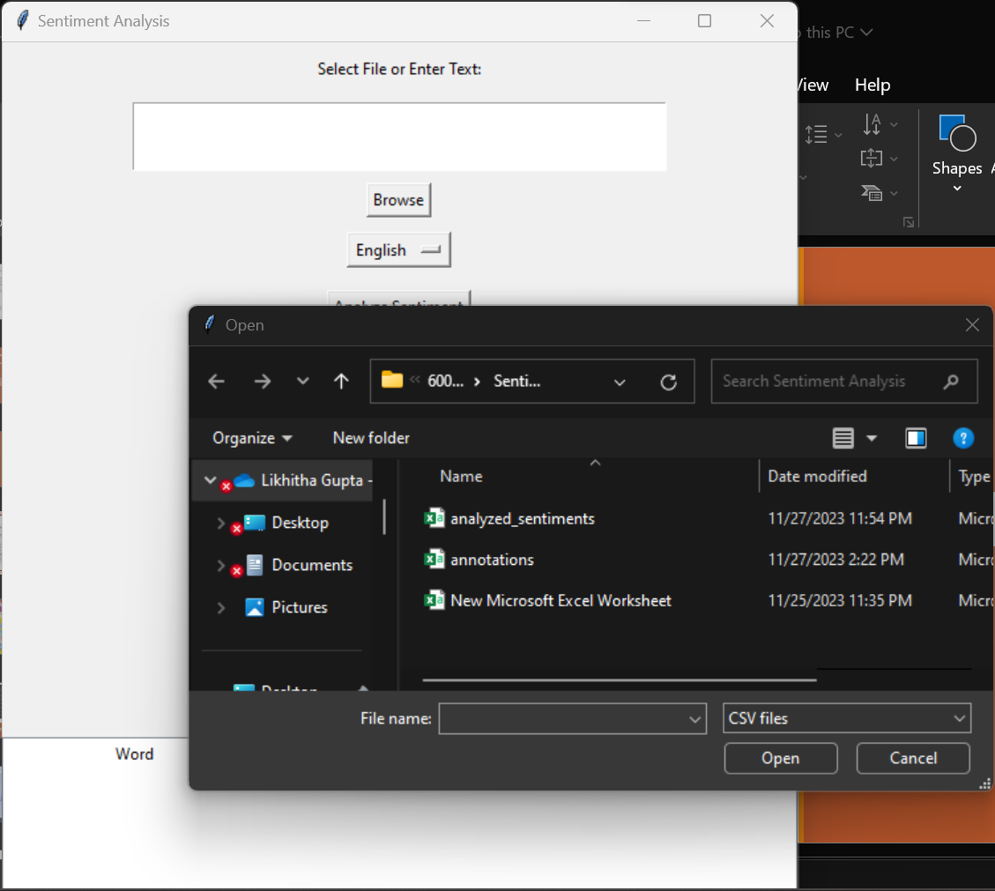

Loading Data

Slide 7

Sentiment Analysis
Functionality:
Analyze sentiment using BERT models
Display sentiment labels and scores for each entry in the List
Save the analyzed sentiments to a new CSV file
.

Slide 8

Predicting Accuracy
Functionality:
Predict accuracy using a BERT model
Display accuracy percentage

Slide 9
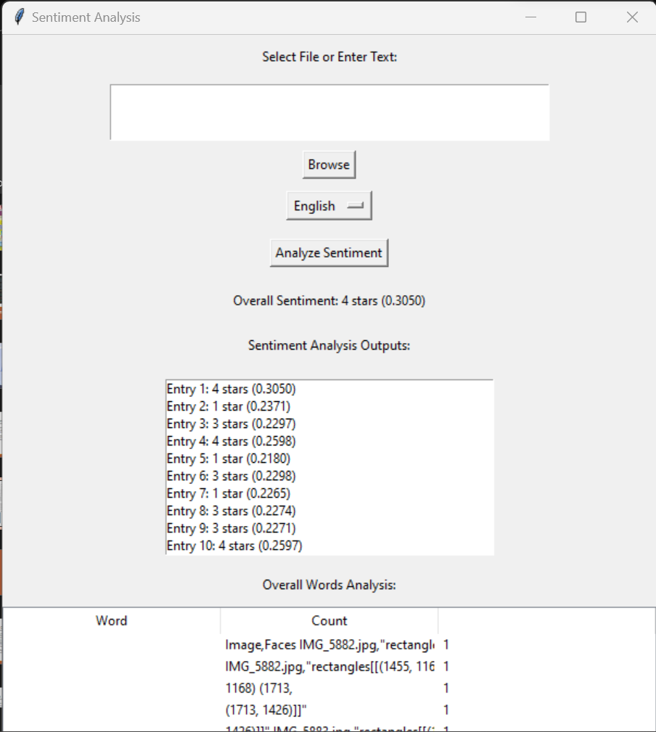
Sentiment Distribution Output 1

Slide 10
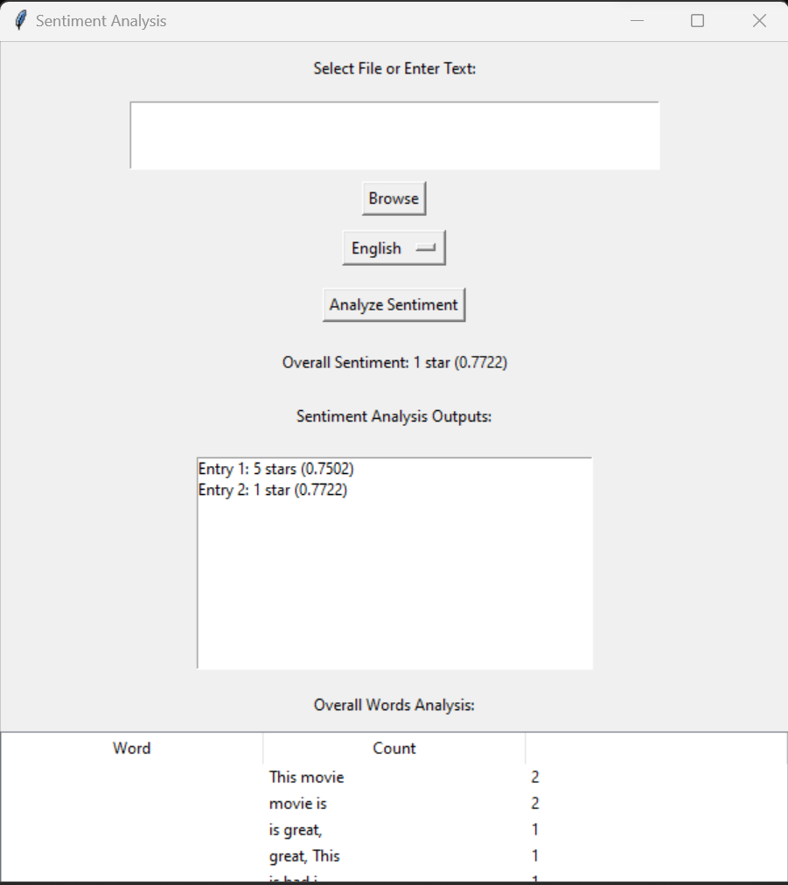
Sentiment Distribution Output 2

Slide 11
Conclusion
Summary:
Developed a Sentiment Analysis GUI
Utilized BERT models for analysis and prediction
Provided visualizations for sentiment distribution

Slide 12
THANK YOU

